Slide 1
Randomized Quick Sort - Reference Video
https://youtu.be/HY64dw_Af94
https://youtu.be/aFswaBnWKLk

Slide 2
Quick-Sort - A Recap
7 4 9 6 2 → 2 4 6 7 9
4 2 → 2 4
7 9 → 7 9
2 → 2
9 → 9

Slide 3
Outline and Reading
Quick-sort (§4.3)
Algorithm
Partition step
Quick-sort tree
Execution example
Analysis of quick-sort (4.3.1)
In-place quick-sort (§4.8)
Summary of sorting algorithms

Slide 4
Quick-Sort
Quick-sort is a randomized sorting algorithm based on the divide-and-conquer paradigm:
Divide: pick a random element x (called pivot) and partition S into
L elements less than x
E elements equal x
G elements greater than x
Recur: sort L and G
Conquer: join L, E and G
x
x
L
E
G
x

Slide 5

Partition
We partition an input sequence as follows:
We remove, in turn, each element y from S and
We insert y into L, E or G, depending on the result of the comparison with the pivot x
Each insertion and removal is at the beginning or at the end of a sequence, and hence takes O(1) time
Thus, the partition step of quick-sort takes O(n) time
Algorithm partition(S, p)
Input sequence S, position p of pivot
Output subsequences L, E, G of the elements of S less than, equal to, or greater than the pivot, resp.
L, E, G ← empty sequences
x ← S.remove(p)
while ¬S.isEmpty()
y ← S.remove(S.first())
if y < x
L.insertLast(y)
else if y = x
E.insertLast(y)
else { y > x }
G.insertLast(y)
return L, E, G

Slide 6
Quick-Sort Tree
An execution of quick-sort is depicted by a binary tree
Each node represents a recursive call of quick-sort and stores
Unsorted sequence before the execution and its pivot
Sorted sequence at the end of the execution
The root is the initial call
The leaves are calls on subsequences of size 0 or 1
7 4 9 6 2 → 2 4 6 7 9
4 2 → 2 4
7 9 → 7 9
2 → 2
9 → 9

Slide 7
Execution Example
Pivot selection
7 2 9 4 3 7 6 1 → 1 2 3 4 6 7 8 9
7 2 9 4 → 2 4 7 9
3 8 6 1 → 1 3 8 6
2 → 2
9 4 → 4 9
3 → 3
8 → 8
9 → 9
4 → 4

Slide 8
Execution Example (cont.)
Partition, recursive call, pivot selection
7 2 9 4 3 7 6 1 → 1 2 3 4 6 7 8 9
2 4 3 1 → 2 4 7 9
3 8 6 1 → 1 3 8 6
2 → 2
9 4 → 4 9
3 → 3
8 → 8
9 → 9
4 → 4

Slide 9
Execution Example (cont.)
Partition, recursive call, base case
7 2 9 4 3 7 6 1 → → 1 2 3 4 6 7 8 9
2 4 3 1 →→ 2 4 7
3 8 6 1 → 1 3 8 6
1 → 1
9 4 → 4 9
3 → 3
8 → 8
9 → 9
4 → 4

Slide 10
Execution Example (cont.)
Recursive call, …, base case, join
7 2 9 4 3 7 6 1 → 1 2 3 4 6 7 8 9
2 4 3 1 → 1 2 3 4
3 8 6 1 → 1 3 8 6
1 → 1
4 3 → 3 4
3 → 3
8 → 8
9 → 9
4 → 4

Slide 11
Execution Example (cont.)
Recursive call, pivot selection
7 2 9 4 3 7 6 1 → 1 2 3 4 6 7 8 9
2 4 3 1 → 1 2 3 4
7 9 7 1 → 1 3 8 6
1 → 1
4 3 → 3 4
8 → 8
9 → 9
9 → 9
4 → 4

Slide 12
Execution Example (cont.)
Partition, …, recursive call, base case
7 2 9 4 3 7 6 1 → 1 2 3 4 6 7 8 9
2 4 3 1 → 1 2 3 4
7 9 7 1 → 1 3 8 6
1 → 1
4 3 → 3 4
8 → 8
9 → 9
9 → 9
4 → 4

Slide 13
Execution Example (cont.)
Join, join
7 2 9 4 3 7 6 1 → 1 2 3 4 6 7 7 9
2 4 3 1 → 1 2 3 4
7 9 7 → 17 7 9
1 → 1
4 3 → 3 4
8 → 8
9 → 9
9 → 9
4 → 4

Slide 14
Worst-case Running Time
The worst case for quick-sort occurs when the pivot is the unique minimum or maximum element
One of L and G has size n − 1 and the other has size 0
The running time is proportional to the sum
n + (n − 1) + … + 2 + 1
Thus, the worst-case running time of quick-sort is O(n²)
depth | time
0 | n
1 | n − 1
… | …
n − 1 | 1
…

Slide 15
Expected Running Time
Consider a recursive call of quick-sort on a sequence of size s
Good call: the sizes of L and G are each less than 3s/4
Bad call: one of L and G has size greater than 3s/4
A call is good with probability 1/2
1/2 of the possible pivots cause good calls:
7 2 9 4 3 7 6 1 9
7 2 9 4 3 7 6 1
2 4 3 1
7 9 7 1 → 1
1
7 2 9 4 3 7 6
Good call
Bad call
1 2 3 4 5 6 7 8 9 10 11 12 13 14 15 16
Bad pivots
Good pivots
Bad pivots

Slide 16
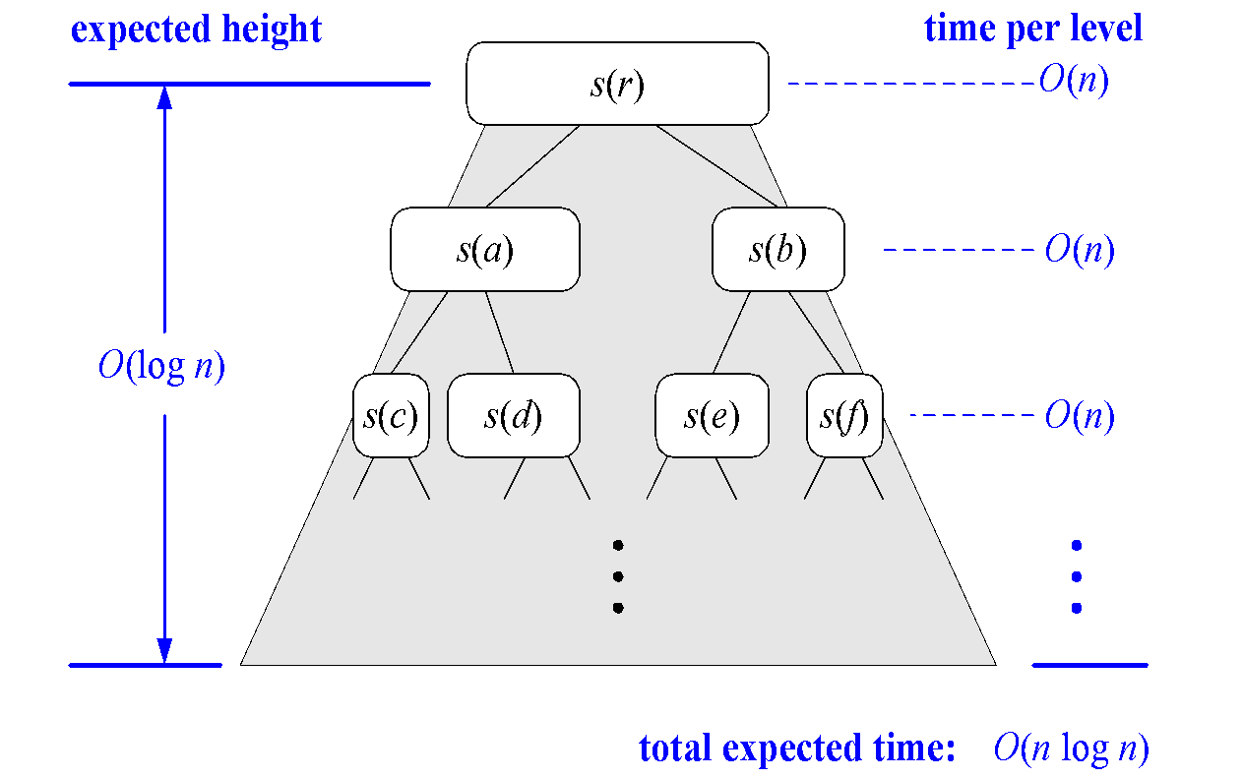
Expected Running Time, Part 2
Probabilistic Fact: The expected number of coin tosses required in order to get k heads is 2k
For a node of depth i, we expect
i/2 ancestors are good calls
The size of the input sequence for the current call is at most (3/4)^{i/2}n
Therefore, we have
For a node of depth 2log_{4/3}n, the expected input size is one
The expected height of the quick-sort tree is O(log n)
The amount or work done at the nodes of the same depth is O(n)
Thus, the expected running time of quick-sort is O(n log n)

Slide 17

In-Place Quick-Sort
Quick-sort can be implemented to run in-place
In the partition step, we use replace operations to rearrange the elements of the input sequence such that
the elements less than the pivot have rank less than h
the elements equal to the pivot have rank between h and k
the elements greater than the pivot have rank greater than k
The recursive calls consider
elements with rank less than h
elements with rank greater than k
Algorithm inPlaceQuickSort(S, l, r)
Input sequence S, ranks l and r
Output sequence S with the elements of rank between l and r rearranged in increasing order
if l ≥ r
return
i ← a random integer between l and r
x ← S.elemAtRank(i)
(h, k) ← inPlacePartition(x)
inPlaceQuickSort(S, l, h − 1)
inPlaceQuickSort(S, k + 1, r)

Slide 18

In-Place Partitioning
Perform the partition using two indices to split S into L and E U G (a similar method can split E U G into E and G).
Repeat until j and k cross:
Scan j to the right until finding an element > x.
Scan k to the left until finding an element < x.
Swap elements at indices j and k
j
k
3 2 5 1 0 7 3 5 9 2 7 9 8 9 7 6 9
(pivot = 6)
j
k
3 2 5 1 0 7 3 5 9 2 7 9 8 9 7 6 9

Slide 19
Summary of Sorting Algorithms
Algorithm | Time | Notes
selection-sort | O(n²) | in-place slow (good for small inputs)
insertion-sort | O(n²) | in-place slow (good for small inputs)
quick-sort | O(n log n) expected | in-place, randomized fastest (good for large inputs)
heap-sort | O(n log n) | in-place fast (good for large inputs)
merge-sort | O(n log n) | sequential data access fast (good for huge inputs)

